Slide 1

Apple inc. Twitter sentiment analysis and stock correlation

Slide 2
Sentiment analysis
Sentiment analysis is the process to determine whether the text (e.g. comments, tweets, reviews) is positive, neutral or negative.

Slide 3
Framework
Naive
Bayes
Label dataset (VADER & AFINN)
Dataset
Preprocessing
SVM
Stock correlation

Slide 4
Preprocessing
1. Remove RT beginning words, remove username, remove URLs, remove single numbers
e.g. @username, '' http://cnb.cx/1xsBWIT "
2. Remove punctations, lower tweets
e.g. "!()-[]{};:'"\,<>./?@#$%^&*_~"
3. tokenization
4. remove stopwords
e.g. “a”, “the”, “is”, “are" and etc
5. Lemmatization & Pos-tagging
Tagged as ADJ, VERB, NOUN, ADV

Slide 5
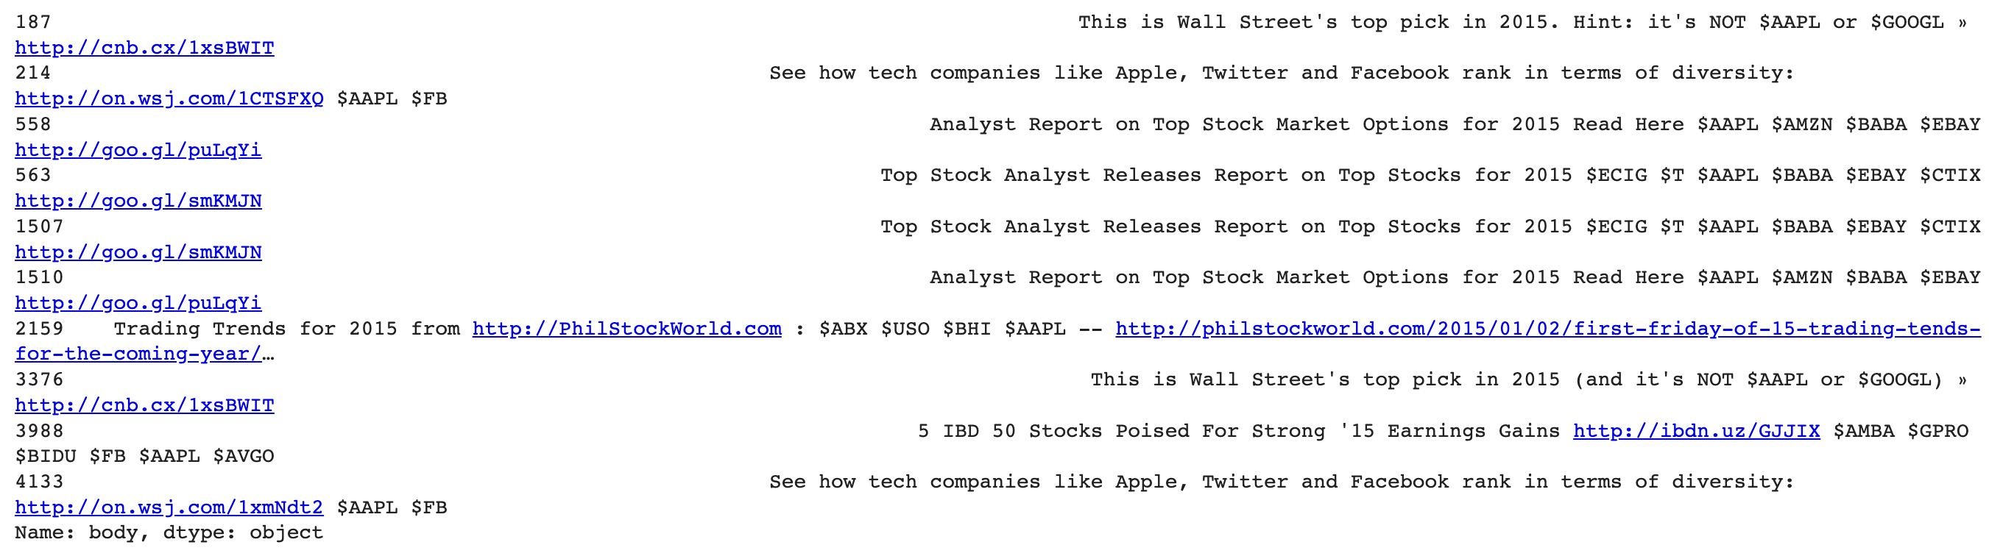
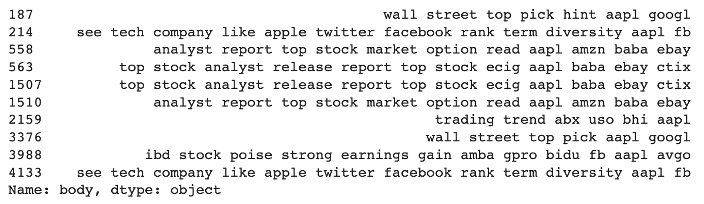
First 10 tweets before preprocessing
First 10 tweets after preprocessing

Slide 6
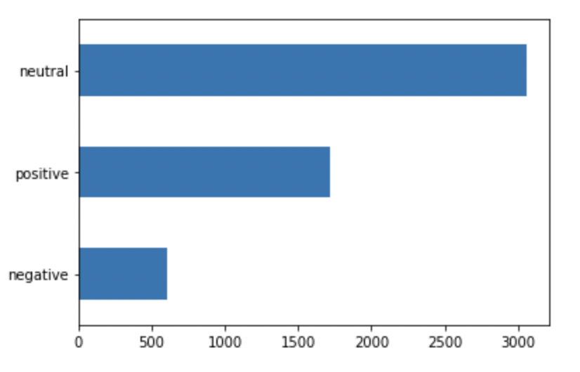
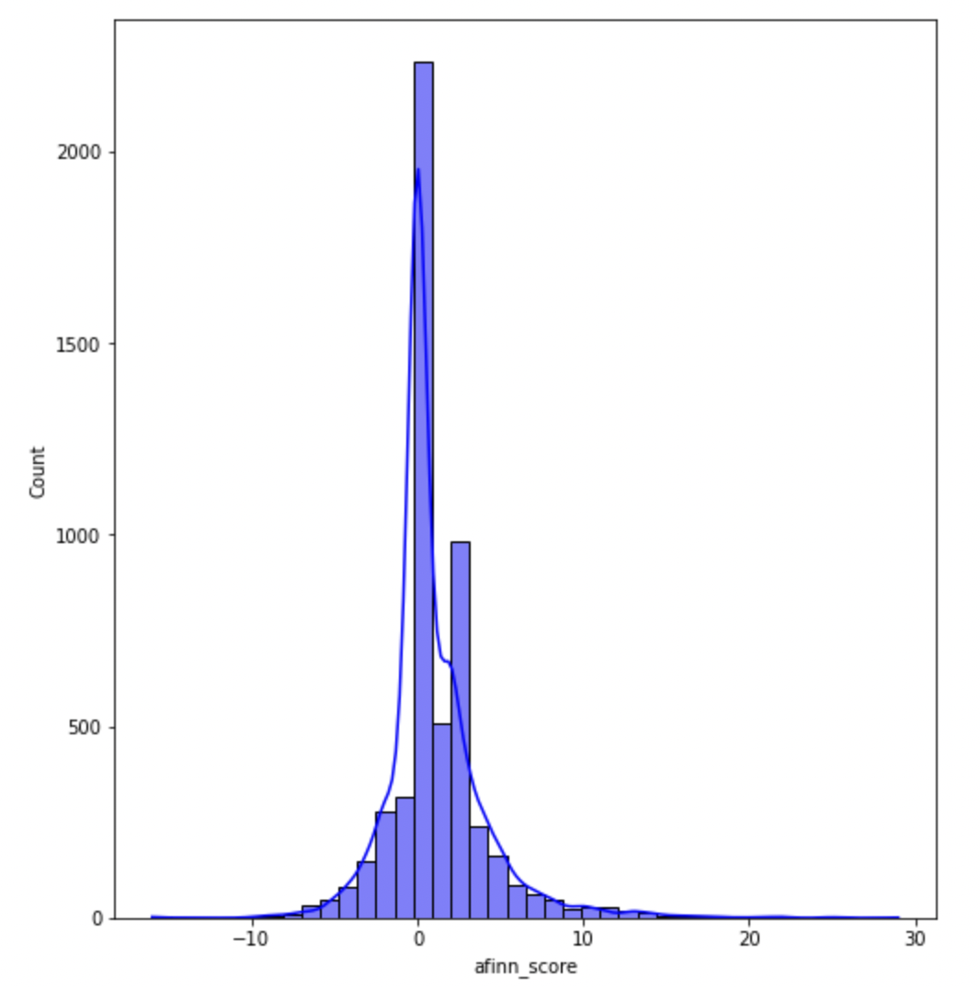
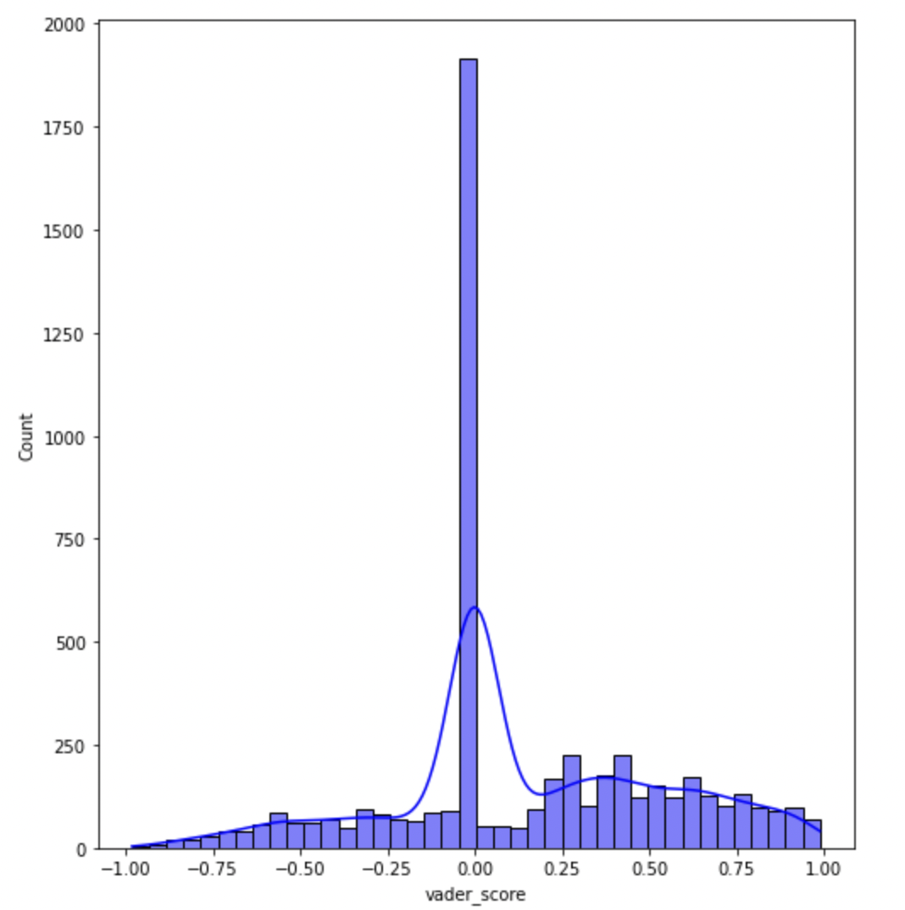
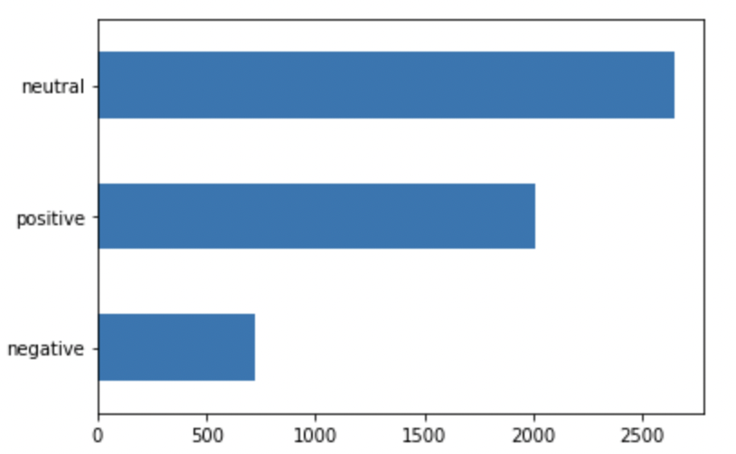
VADER & AFINN
A lexicon, rule-based sentiment analysis tool
A wordlist-based tool for sentiment analysis
Sentiment score distribution

Slide 7
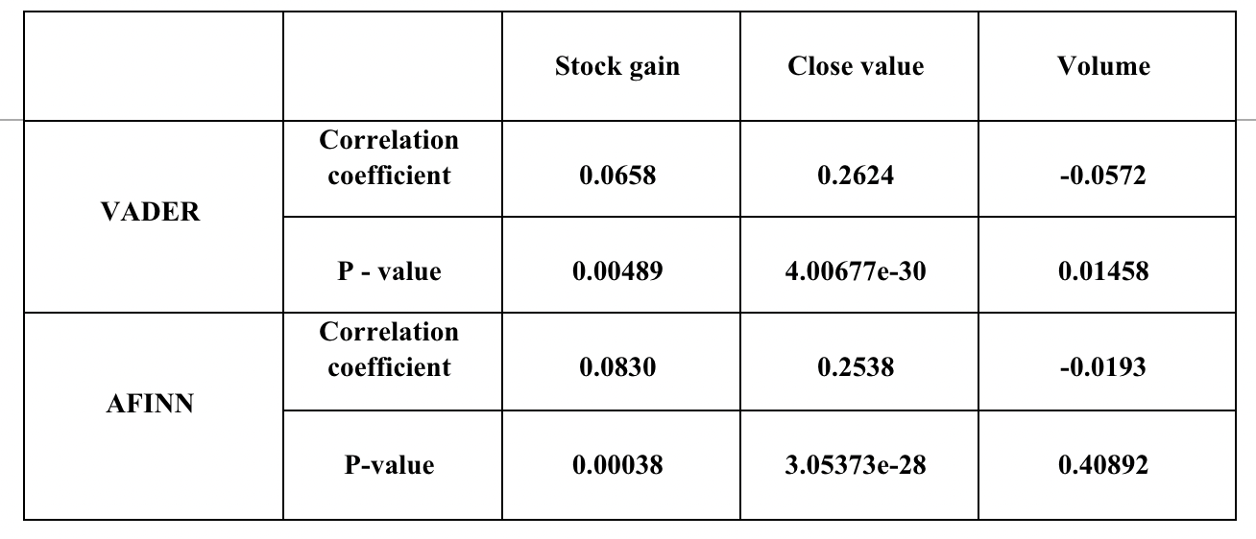
Stock and SENTIMENT correlation
H0 (Null hypothesis): there is no correlation between sentiment and stock.
H1(Alternate hypothesis): there is a correlation between sentiment and stock

Slide 8
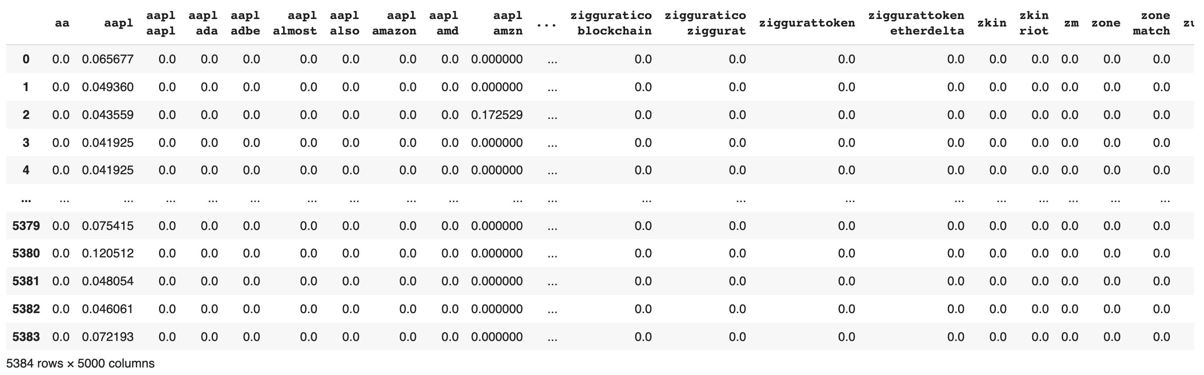
Feature extraction
TF-IDF
TF: term frequency
IDF: inverse document frequency
𝑤𝑡 = 𝑡𝑓𝑡 ⋅log(𝑁 / 𝐷𝐹𝑡 ) for term t

Slide 9
Naive Bayes classifier
A well-known Bayesian network classifier is the Naïve Bayes’ classifier is a probabilistic classifier based on Bayes’ theorem, considering Naïve (Strong) independence assumption. (Dey, et al. 2016)
Bayes' theorem:
P(A|B) = P(B|A)P(A) / P(B)
Assumption: feature independence
Application: Sentiment analysis, Email spam filtering
Support Vector Machine (SVM)
“Support Vector Machine” (SVM) is a supervised machine learning algorithm that can be used for both classification and regression challenges. However, it is mostly used in classification problems. (Ray, 2017) SVM performs classification by finding the hyper-plane that differentiate the classes we plotted in n-dimensional space. (Reddy, 2020)
Application: Text classification, Sentiment Analysis, image classification

Slide 10
Evaluation metrics
Precision
Precision = TP / TP + FP
Recall
Recall = TP / TP + FN
F1 – score
F1 – score = 2 * (Precision * Recall) / (Precision + Recall)
Accuracy = TP + TN / TP + TF + FP + FN

Slide 11
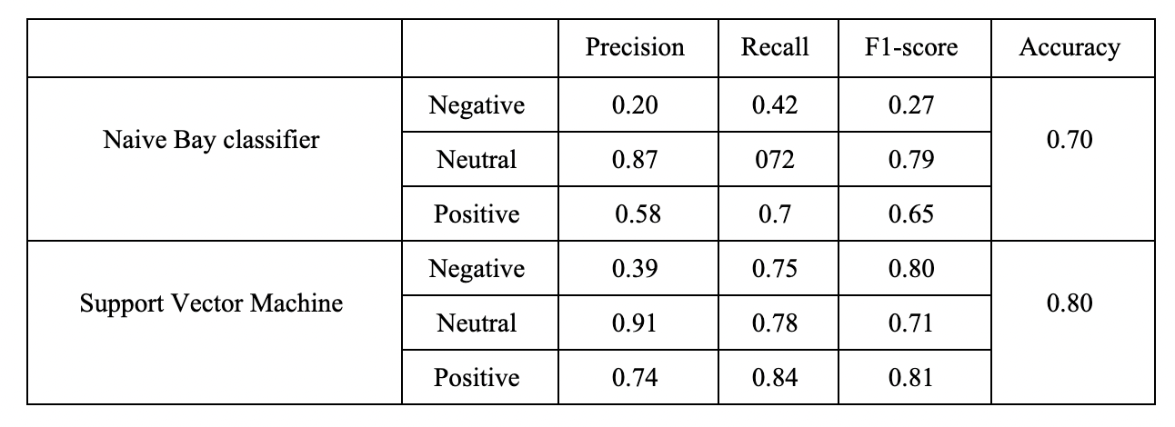
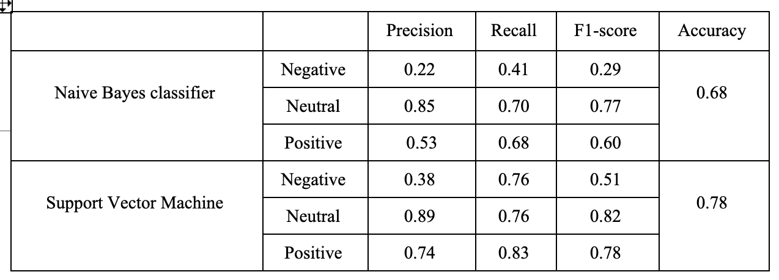
AFFIN AND VADER METRIC TABLE
LABELLED WITH LABEL
LABELLED WITH AFFIN

Slide 12
Future work
More feature extraction techniques: bag-of-word, word2vec
Use unigram, bigram, n-gram models before lexicon-based approaches
Unsupervised learning model: k-means
Deeper leanring model: LSTM
Hyperparameter-tuning

Slide 13

Questions?

Slide 14
References
Dashtipour, K., Poria, S., Hussain, A. et al. (2016) Multilingual Sentiment Analysis: State of the Art and Independent Comparison of Techniques. Cogn Comput 8, 757–771.
Sunil Ray. (2017) Understanding Support Vector Machine (SVM) algorithm from examples (along with code), https://www.analyticsvidhya.com/blog/2017/09/understaing-support-vector-machine-example-code/
Reddy, V. (2020, June 23). Sentiment analysis using SVM. Medium. Retrieved December 6, 2022, from https://medium.com/@vasista/sentiment-analysis-using-svm-338d418e3ff1#:~:text=SVM%20performs%20classification%20by%20finding,plotted%20in%20n%2Ddimensional%20space.&text=The%20tuning%20parameter%20Kernel%20%E2%80%94%20%E2%80%9CRBF,prior%20knowledge%20about%20the%20data.

